Slide 1



Episode 56WU1 August 11, 2024, Jeopardy. Top electricity source Alabama to New Jersey PLEASE CLICK TO START THE GAME!

Slide 2


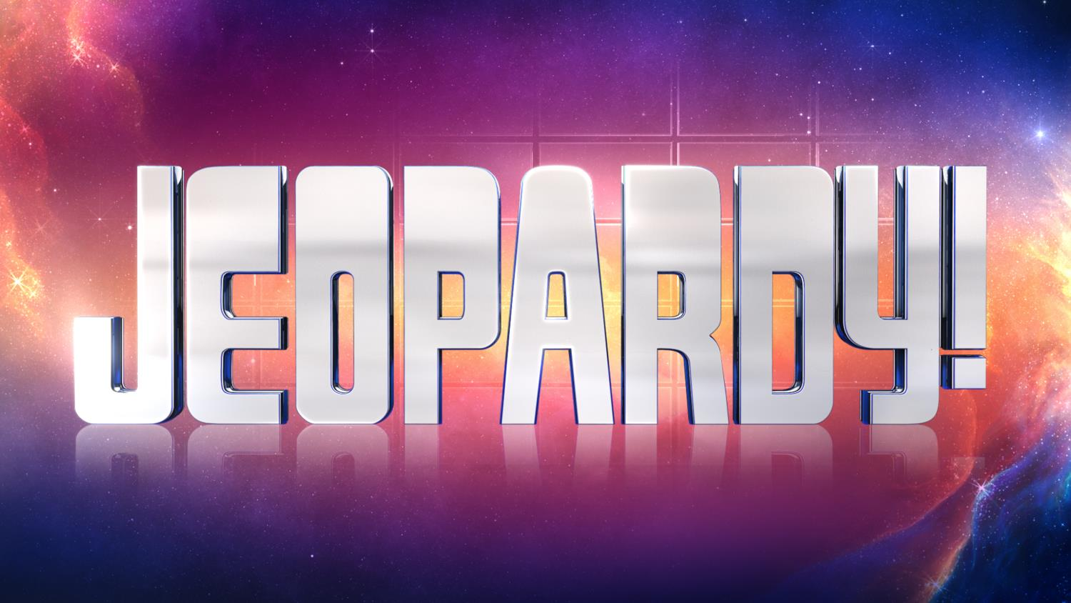
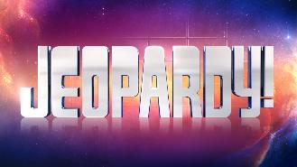



$ 200
$ 200
$ 200
$ 200
$ 200
$ 200
$ 400
$ 400
$ 400
$ 400
$ 400
$ 400
$ 600
$ 600
$ 600
$ 600
$ 600
$ 600
$ 800
$ 800
$ 800
$ 800
$ 800
$ 800
$ 1000
$ 1000
$ 1000
$ 1000
$ 1000
$ 1000

Slide 3


Slide 4
Category 1)
Alabama, Alaska, Arizona, Arkansas or
California

Slide 6

Category 2)
Colorado, Connecticut,
Delaware, Florida or Georgia

Slide 8

Category 3)
Hawaii, Idaho,
Illinois, Indiana or
Iowa

Slide 10
Category 4)
Kansas, Kentucky,
Louisiana, Maine or
Maryland

Slide 12
Category 5)
Massachusetts, Michigan,
Minnesota, Mississippi or
Missouri

Slide 14
Category 6)
Montana, Nebraska
Nevada, NewHampshire,
or New Jersey

Slide 15
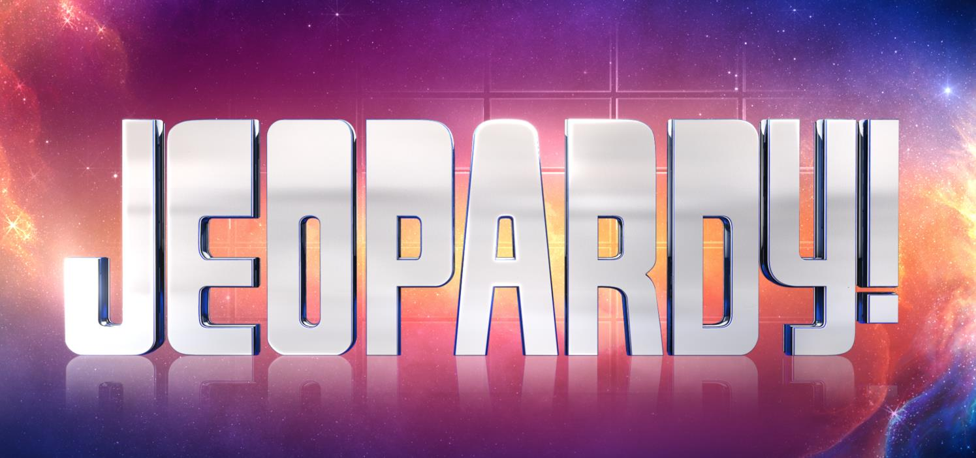
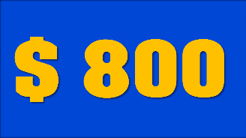

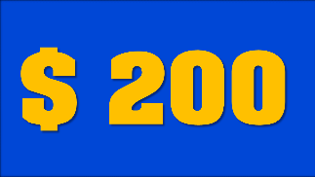
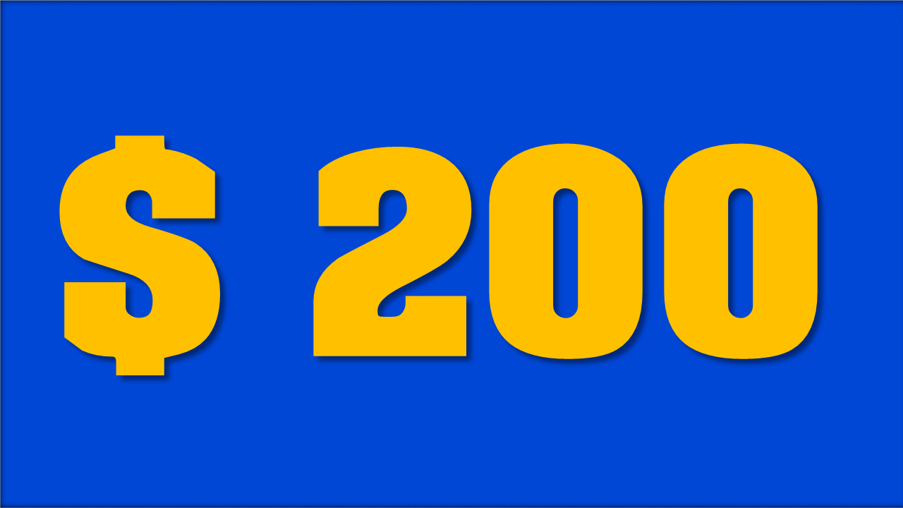



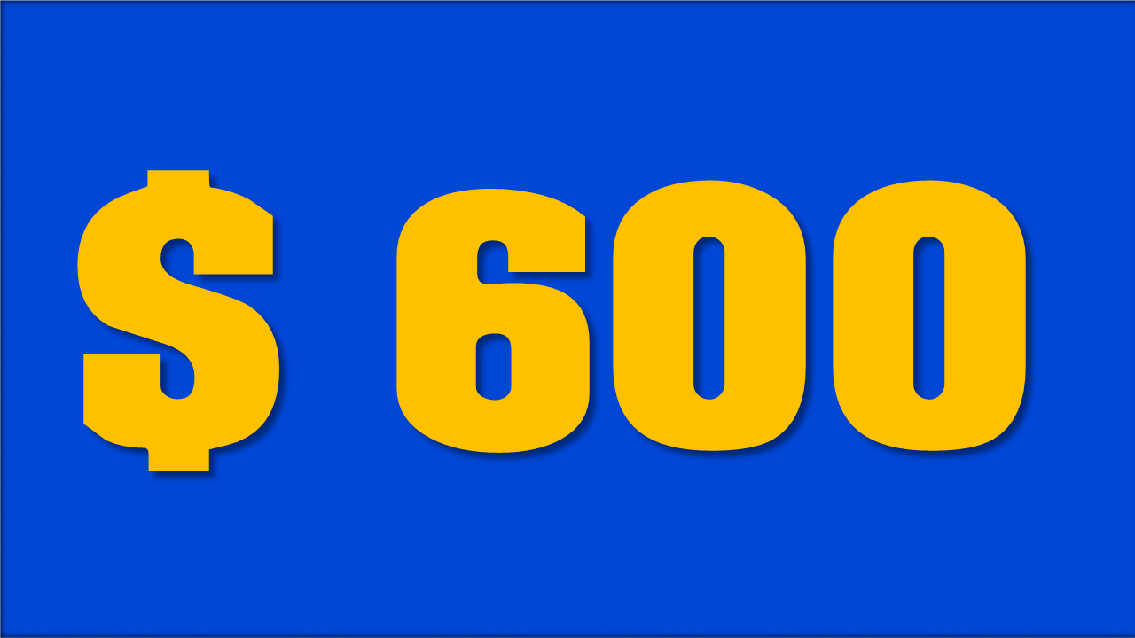

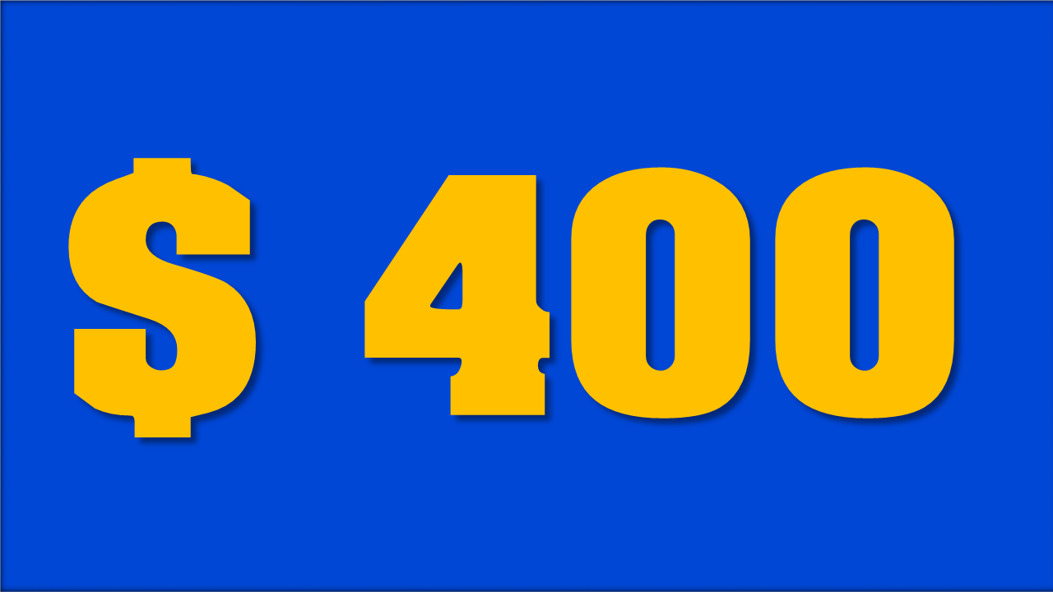
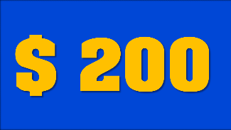

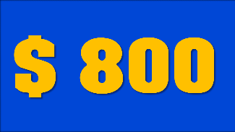




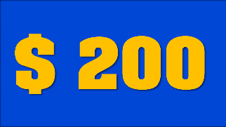


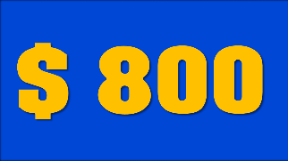


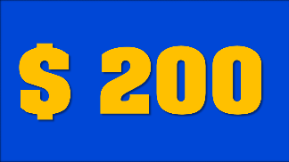




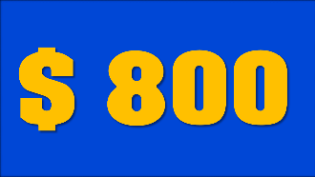



RHYME
TIME!
MOVIE
CLASSICS
EASY BUT
SO MEAN
-QUESTIONS-
HAIRY AFFAIR
BROADWAY
MUSICALS
POPULAR SPEECHES
YOU FINISHED THIS GAME
TIME TO COUNT THE MONEY!

Slide 16
Category 1, $200 Answer, In Blank United State Natural Gas is the top electricity source. Hydro is the top renewable energy source. If wood burning is considered carbon free in Blank United State because of the scientifically debunked theory of Carbon Neutrality of Wood Burning and if Blank United State replaced coal burning with wood burning based on that scientifically debunked theory then on paper Blank United State might seem to be meeting carbon free goals while in reality producing more air pollution than with coal burning. Blank United State is an energy exporter.
Click here for the answer

Slide 17
Solution:
Category 1, $200 Question, What is Alabama?
$ 200

Slide 18
Category 1, $400 Answer, In Blank United State Natural Gas is the top electricity source. There is some use of wind power. Blank United State is not an energy exporter nor an energy importer. Wood burning is not mentioned in this article although wood burning is a significant source of air pollution in many areas of Blank United State. If wood burning is considered carbon free in Blank United State because of the scientifically debunked theory of Carbon Neutrality of Wood Burning and if Blank United State replaced coal burning with wood burning based on that scientifically debunked theory then on paper Blank United State might seem to be meeting carbon free goals while in reality producing more air pollution than with coal burning.
Click here for the answer

Slide 19
Solution:
Category 1, $400 Question, What is Alaska?
$ 400

Slide 20
Category 1, $600 Answer, In Blank United State Natural Gas is the top electricity source at 46 percent. Nuclear power is also a large source of energy. Blank United State Public Service set a voluntary goal of getting 65 percent of its electricity from carbon-free sources by 2030. If wood burning is considered carbon free in Blank United State because of the scientifically debunked theory of Carbon Neutrality of Wood Burning and if Blank United State replaced coal burning with wood burning based on that scientifically debunked theory then on paper Blank United State might seem to be meeting carbon free goals while in reality producing more air pollution than with coal burning.
Click here for the answer

Slide 21
Solution:
Category 1, $600 Question, What is Arizona?
$ 600

Slide 22
Category 1, $800 Answer, In Blank United State Natural Gas is the top electricity source since 2022. Blank United State is an energy exporter. If wood burning is considered carbon free in Blank United State because of the scientifically debunked theory of Carbon Neutrality of Wood Burning and if Blank United State replaced coal burning with wood burning based on that scientifically debunked theory then on paper Blank United State might seem to be meeting carbon free goals while in reality producing more air pollution than with coal burning.
Click here for the answer

Slide 23
Category 1, $800 Question, What is Arkansas?
$ 800

Slide 24
Category 1, $1,000 Answer, In Blank United State Natural Gas is the top electricity source since 2001. This article does not mention wood burning in Blank United State. If wood burning is considered carbon free in Blank United State because of the scientifically debunked theory of Carbon Neutrality of Wood Burning and if Blank United State replaced coal burning with wood burning based on that scientifically debunked theory then on paper Blank United State might seem to be meeting carbon free goals while in reality producing more air pollution than with coal burning. Blank United State imports energy.
Click here for the answer

Slide 25
Solution:
Category 1, $1,000 Question, What is California?
$ 1000

Slide 26
Category 2, $200 Answer, In Blank United State Coal is the top electricity source since 2001. Wind power is the third largest source of energy in Blank United State behind natural gas. This article does not mention wood burning in Blank United State. If wood burning is considered carbon free in Blank United State because of the scientifically debunked theory of Carbon Neutrality of Wood Burning and if Blank United State replaced coal burning with wood burning based on that scientifically debunked theory then on paper Blank United State might seem to be meeting carbon free goals while in reality producing more air pollution than with coal burning. Blank United State imports energy.
Click here for the answer

Slide 27
Solution:
Category 2, $200 Question, What is Colorado?
$ 200

Slide 28
Category 2, $400 Answer, In Blank United State Natural Gas is the top electricity source since 2001. Nuclear power is a substantial energy source in Blank United State. This article does not mention wood burning in Blank United State. If wood burning is considered carbon free in Blank United State because of the scientifically debunked theory of Carbon Neutrality of Wood Burning and if Blank United State replaced coal burning with wood burning based on that scientifically debunked theory then on paper Blank United State might seem to be meeting carbon free goals while in reality producing more air pollution than with coal burning.
Click here for the answer

Slide 29
Solution:
Category 2, $400 Question, What is Connecticut?
$ 400

Slide 30
Category 2, $600 Answer, In Blank United State Natural Gas is the top electricity source since 2010. Solar supplies ten percent of Blank United State energy. This article does not mention wood burning in Blank United State. If wood burning is considered carbon free in Blank United State because of the scientifically debunked theory of Carbon Neutrality of Wood Burning and if Blank United State replaced coal burning with wood burning based on that scientifically debunked theory then on paper Blank United State might seem to be meeting carbon free goals while in reality producing more air pollution than with coal burning. Blank United State imports energy.
Click here for the answer

Slide 31
Solution:
Category 2, $600 Question, What is Delaware?
$ 600

Slide 32
Category 2, $800 Answer, In Blank United State Natural Gas is the top electricity source since 2003, supplying 75% of Blank United State energy since 2023. In 2024, Blank United State lawmakers passed a bill that cuts support for renewable energy projects and makes it easier to build natural gas infrastructure. This article does not mention wood burning in Blank United State. If wood burning is considered carbon free in Blank United State because of the scientifically debunked theory of Carbon Neutrality of Wood Burning and if Blank United State replaced coal burning with wood burning based on that scientifically debunked theory then on paper Blank United State might seem to be meeting carbon free goals while in reality producing more air pollution than with coal burning. Blank United State is the second-largest producer of electricity nationwide, after Blank United State, but still imports a small amount of power from neighboring states to meet consumer demand
Click here for the answer

Slide 33
Solution:
Category 2, $800 Question, What is Florida?
$ 800

Slide 34
Category 2, $1,000 Answer, In Blank United State Natural Gas is the top electricity source for most of the last decade, with nuclear power in second place. Blank United State is the only state to bring new nuclear capacity online in recent years: Two new reactors that opened in 2023 and 2024. Blank United State is also still expanding fossil fuel power. This article does not mention wood burning in Blank United State. If wood burning is considered carbon free in Blank United State because of the scientifically debunked theory of Carbon Neutrality of Wood Burning and if Blank United State replaced coal burning with wood burning based on that scientifically debunked theory then on paper Blank United State might seem to be meeting carbon free goals while in reality producing more air pollution than with coal burning.
Click here for the answer

Slide 35
Solution:
Category 2, $1,000 Question, What is Georgia?
$ 1000

Slide 36
Category 3, $200 Answer, In Blank United State imported oil is the top electricity source. The state recently opened a new, large-scale battery storage facility as part of its strategy to replace the coal power that was retired. (Battery charging and discharging is not shown in the charts above, which reflect net generation.) If wood burning is considered carbon free in Blank United State because of the scientifically debunked theory of Carbon Neutrality of Wood Burning and if Blank United State replaced coal burning with wood burning based on that scientifically debunked theory then on paper Blank United State might seem to be meeting carbon free goals while in reality producing more air pollution than with coal burning.
Click here for the answer

Slide 37
Solution:
Category 3, $200 Question, What is Hawaii?
$ 200

Slide 38
Category 3, $400 Answer, In Blank United State Hydro generated the vast majority of Blank United State’s electricity during the 2000s and early 2010s. But in recent years, drought conditions have pushed down the amount of hydroelectric power produced in the state. Blank United State still makes the majority of its electricity from renewable sources, with hydro providing 43 percent of in-state power generation last year and wind and solar together providing an additional 22 percent. But natural gas power has expanded significantly at the same time. If wood burning is considered carbon free in Blank United State because of the scientifically debunked theory of Carbon Neutrality of Wood Burning and if Blank United State replaced coal burning with wood burning based on that scientifically debunked theory then on paper Blank United State might seem to be meeting carbon free goals while in reality producing more air pollution than with coal burning. Blank United State is an energy importer.
Click here for the answer

Slide 39
Solution:
Category 3, $400 Question, What is Idaho?
$ 400

Slide 40
Category 3, $600 Answer, In Blank United State Nuclear Power is the top electricity source. If wood burning is considered carbon free in Blank United State because of the scientifically debunked theory of Carbon Neutrality of Wood Burning and if Blank United State replaced coal burning with wood burning based on that scientifically debunked theory then on paper Blank United State might seem to be meeting carbon free goals while in reality producing more air pollution than with coal burning. Blank United State is an energy exporter.
Click here for the answer

Slide 41
Solution:
Category 3, $600 Question, What is Illinois?
$ 600

Slide 42
Category 3, $800 Answer, In Blank United State Coal is the top electricity source. If wood burning is considered carbon free in Blank United State because of the scientifically debunked theory of Carbon Neutrality of Wood Burning and if Blank United State replaced coal burning with wood burning based on that scientifically debunked theory then on paper Blank United State might seem to be meeting carbon free goals while in reality producing more air pollution than with coal burning. Blank United State is an energy importer.
Click here for the answer

Slide 43
Solution:
Category 3, $800 Question, What is Indiana?
$ 800

Slide 44
Category 3, $1,000 Answer, In Blank United State Wind is the top electricity source. If wood burning is considered carbon free in Blank United State because of the scientifically debunked theory of Carbon Neutrality of Wood Burning and if Blank United State replaced coal burning with wood burning based on that scientifically debunked theory then on paper Blank United State might seem to be meeting carbon free goals while in reality producing more air pollution than with coal burning. Blank United State is an energy exporter.
Click here for the answer

Slide 45
Category 3, $1,000 Question, What is Iowa?
$ 1000

Slide 46
Category 4, $200 Answer, In Blank United State Wind is the top electricity source. If wood burning is considered carbon free in Blank United State because of the scientifically debunked theory of Carbon Neutrality of Wood Burning and if Blank United State replaced coal burning with wood burning based on that scientifically debunked theory then on paper Blank United State might seem to be meeting carbon free goals while in reality producing more air pollution than with coal burning. Blank United State is an energy exporter.
Click here for the answer

Slide 47
Solution:
Category 4, $200 Question, What is Kansas?
$ 200

Slide 48
Category 4, $400 Answer, In Blank United State Coal is the top electricity source. A number of the state’s older, coal-fired power plants have shut down or been converted to burn natural gas over the past 10 years. If wood burning is considered carbon free in Blank United State because of the scientifically debunked theory of Carbon Neutrality of Wood Burning and if Blank United State replaced coal burning with wood burning based on that scientifically debunked theory then on paper Blank United State might seem to be meeting carbon free goals while in reality producing more air pollution than with coal burning.
Click here for the answer

Slide 49
Category 4, $400 Question, What is Kentucky?
$ 400

Slide 50
Category 4, $600 Answer, In Blank United State Natural Gas is the top electricity source. Hydro is the top renewable energy source. Last year, gas accounted for 76 percent of electricity made in the state, up from 46 percent in 2001. If wood burning is considered carbon free in Blank United State because of the scientifically debunked theory of Carbon Neutrality of Wood Burning and if Blank United State replaced coal burning with wood burning based on that scientifically debunked theory then on paper Blank United State might seem to be meeting carbon free goals while in reality producing more air pollution than with coal burning. Blank United State is an energy importer.
Click here for the answer

Slide 51
Category 4, $600 Question, What is Louisiana?
$ 600

Slide 52
Category 4, $800 Answer, Most of the electricity generated in Blank United State last year came from renewable sources. Together, hydroelectric dams, wind turbines, solar arrays and biomass plants, which burn wood and other organic materials, produced about 69 percent of the state’s power. Blank United State uses wood burning as a renewable although it is a polluting renewable unlike Wind and Solar which are clean renewables. If wood burning is considered carbon free in Blank United State because of the scientifically debunked theory of Carbon Neutrality of Wood Burning and Blank United State replaced coal burning with wood burning based on that scientifically debunked theory then on paper Blank United State might seem to be meeting carbon free goals while in reality producing more air pollution than with coal burning. Blank United State is an energy importer.
Click here for the answer

Slide 53
Solution:
Category 4, $800 Question, What is Maine?
$ 800

Slide 54
Category 4, $1,000 Answer, In Blank United State Coal is the top electricity source. Hydro is the top renewable energy source. Natural gas is second and nuclear power third. If wood burning is considered carbon free in Blank United State because of the scientifically debunked theory of Carbon Neutrality of Wood Burning and if Blank United State replaced coal burning with wood burning based on that scientifically debunked theory then on paper Blank United State might seem to be meeting carbon free goals while in reality producing more air pollution than with coal burning. Blank United State is an energy importer. Episode 56WRC August 9, 2024. How Your State Makes Electricity. Blank United State to Blank United State
Click here for the answer

Slide 55
Solution:
Category 4, $1,000 Question, What is Maryland?
$ 1000

Slide 56
Category 5, $200 Answer, In Blank United State Natural Gas is the top electricity source. The state’s only nuclear plant, which was responsible for between 10 and 20 percent of the state’s electricity generation in previous years, shut down permanently in 2019, partly because of competition from cheaper natural gas. Solar power provides nearly of quarter of the state’s power. The state’s first offshore wind project started producing electricity this year. This article does not mention wood burning in Blank United State. If wood burning is considered carbon free in Blank United State because of the scientifically debunked theory of Carbon Neutrality of Wood Burning and if Blank United State replaced coal burning with wood burning based on that scientifically debunked theory then on paper Blank United State might seem to be meeting carbon free goals while in reality producing more air pollution than with coal burning. Blank United State is an energy importer.
Click here for the answer

Slide 57
Solution:
Category 5, $200 Question, What is Massachusetts?
$ 200

Slide 58
Category 5, $400 Answer, In Blank United State Natural Gas is the top electricity source in 2023. Nuclear was the second-largest source of power produced in the state last year, with coal falling to third place. To shore up more emissions-free power, Blank United State now wants to reopen a nuclear plant that shut down in 2022, with help from a $1.5 billion loan from the Biden administration. If the plan goes through, it would be the first shuttered nuclear plant to reopen in the United States. Wind power generated an additional 7 percent, and solar delivered less than 2 percent. This article does not mention wood burning in Blank United State. If wood burning is considered carbon free in Blank United State because of the scientifically debunked theory of Carbon Neutrality of Wood Burning and if Blank United State replaced coal burning with wood burning based on that scientifically debunked theory then on paper Blank United State might seem to be meeting carbon free goals while in reality producing more air pollution than with coal burning.
Click here for the answer

Slide 59
Solution:
Category 5, $400 Question, What is Michigan?
$ 400

Slide 60
Category 5, $600 Answer, In Blank United State emissions-free energy sources, including wind, solar and nuclear power, now provide more than 50 percent of the power produced in Blank United State. In Blank United State Wind became the state’s top power producer last year. In Blank United State until 2023 Nuclear was the top electricity source with coal power in second place. This article does not mention wood burning in Blank United State. If wood burning is considered carbon free in Blank United State because of the scientifically debunked theory of Carbon Neutrality of Wood Burning and if Blank United State replaced coal burning with wood burning based on that scientifically debunked theory then on paper Blank United State might seem to be meeting carbon free goals while in reality producing more air pollution than with coal burning. Blank United State is an energy importer.
Click here for the answer

Slide 61
Solution:
Category 5, $600 Question, What is Minnesota?
$ 600

Slide 62
Category 5, $800 Answer, In Blank United State Natural Gas powered more than three-quarters of the electricity generated in Blank United State last year. This article does not mention wood burning in Blank United State. If wood burning is considered carbon free in Blank United State because of the scientifically debunked theory of Carbon Neutrality of Wood Burning and if Blank United State replaced coal burning with wood burning based on that scientifically debunked theory then on paper Blank United State might seem to be meeting carbon free goals while in reality producing more air pollution than with coal burning. Blank United State is an energy exporter.
Click here for the answer

Slide 63
Category 5, $800 Question, What is Mississippi?
$ 800

Slide 64
Category 5, $1,000 Answer, In Blank United State Coal is the top electricity source, with nuclear power in second place. If wood burning is considered carbon free in Blank United State because of the scientifically debunked theory of Carbon Neutrality of Wood Burning and if Blank United State replaced coal burning with wood burning based on that scientifically debunked theory then on paper Blank United State might seem to be meeting carbon free goals while in reality producing more air pollution than with coal burning. Blank United State is an electricity importer.
Click here for the answer

Slide 65
Solution:
Category 5, $1,000 Question, What is Missouri?
$ 1000

Slide 66
Category 6 $200 Answer, In Blank United State Coal is the top electricity source for most of the last decade. Hydro, long the state’s second-largest source of electricity, briefly surpassed coal as the top power-producer in 2020, but hydroelectric generation dropped significantly by 2023 amid drought conditions. This article does not mention wood burning in Blank United State. If wood burning is considered carbon free in Blank United State because of the scientifically debunked theory of Carbon Neutrality of Wood Burning and if Blank United State replaced coal burning with wood burning based on that scientifically debunked theory then on paper Blank United State might seem to be meeting carbon free goals while in reality producing more air pollution than with coal burning. Blank United State is an energy exporter.
Click here for the answer

Slide 67
Category 6 $200 Question, What is Montana?
$ 200

Slide 68
Category 6, $400 Answer, In Blank United State Coal is the top electricity source. The coal generation share has declined in recent years as wind power has surged. The amount of nuclear power produced in Blank United State also declined after one of the state’s two nuclear plants, Fort Calhoun, permanently shut down in 2016 for economic reasons. Blank United State, like many Great Plains states, has excellent wind resources, according to the U.S. Energy Information Administration, but as more wind turbines and solar farms have been built, local opposition to the projects has increased. Several Blank United State counties recently put in place moratoriums on new wind and solar projects, and others have instituted strict requirements for where they can be built. This article does not mention wood burning in Blank United State. If wood burning is considered carbon free in Blank United State because of the scientifically debunked theory of Carbon Neutrality of Wood Burning and if Blank United State replaced coal burning with wood burning based on that scientifically debunked theory then on paper Blank United State might seem to be meeting carbon free goals while in reality producing more air pollution than with coal burning. Blank United State is an energy exporter.
Click here for the answer

Slide 69
Category 6, $400 Question, What is Nebraska?
$ 400

Slide 70
Category 6, $600 Answer, In Blank United State Natural Gas is the top electricity source since 2005. More recently, solar has surged to become the state’s second-largest source of electricity. Many of the state’s older, coal-fired power plants have shuttered over the past two decades because of competition from cheaper natural gas and state laws that require renewable energy development. Blank United State’s two remaining coal plants are scheduled to be converted to natural gas by 2026. Last year, about 40 percent of the power produced in the state came from renewable energy. Large-scale solar arrays and rooftop panels provided 26 percent. Geothermal plants, which harvest heat from deep beneath the Earth’s surface, supplied an additional 10 percent. Most of the rest came from hydro. The Hoover Dam, one of the country’s largest hydroelectric dams, sits on Blank United State’s border with Blank United State, providing power to both states. This article does not mention wood burning in Blank United State. If wood burning is considered carbon free in Blank United State because of the scientifically debunked theory of Carbon Neutrality of Wood Burning and if Blank United State replaced coal burning with wood burning based on that scientifically debunked theory then on paper Blank United State might seem to be meeting carbon free goals while in reality producing more air pollution than with coal burning.
Click here for the answer

Slide 71
Category 6, $600 Question, What is Nevada?
$ 600

Slide 72
Category 6, $800 Answer, In Blank United State the bulk of electricity generated in Blank United State over the past two decades has come from the state’s only nuclear reactor, Seabrook Station. Natural gas has been the state’s second-largest source of power since the early 2000s, when two new generating stations went online. Blank United State currently generates about 16 percent of its electricity from renewable sources, mostly hydro and biomass, a type of energy that comes from burning wood and other organic matter. If wood burning is considered carbon free in Blank United State because of the scientifically debunked theory of Carbon Neutrality of Wood Burning and if Blank United State replaced coal burning with wood burning based on that scientifically debunked theory then on paper Blank United State might seem to be meeting carbon free goals while in reality producing more air pollution than with coal burning.
Click here for the answer

Slide 73
Solution:
Category 6, $800 Question, What is New Hampshire?
$ 800

Slide 74
Category 6, $1,000 Answer, In Blank United State Natural Gas is the top electricity source since 2015. Nuclear was the top source of electricity generation in Blank United State until 2015, when natural gas surpassed it for the first time. Over the past decade, natural gas and nuclear energy have produced almost all of the state’s electricity, but solar has made inroads, supplying 7 percent of power last year. In 2018, the state’s Oyster Creek nuclear plant, the oldest in the country at the time, closed down, partly because of competition from cheaper natural gas. That same year, the Blank United State Legislature approved new subsidies to keep the state’s remaining three nuclear plants profitable. Blank United State wants to build wind farms off its coast, where there is considerable wind power potential. But proposed projects have stirred up fierce local opposition. This article does not mention wood burning in Blank United State. If wood burning is considered carbon free in Blank United State because of the scientifically debunked theory of Carbon Neutrality of Wood Burning and if Blank United State replaced coal burning with wood burning based on that scientifically debunked theory then on paper Blank United State might seem to be meeting carbon free goals while in reality producing more air pollution than with coal burning. Blank United State is an energy importer.
Click here for the answer

Slide 75
Category 6, $1,000 Question, What is New Jersey?
Double Jeopardy if no action is taken to stop wood burning.
$ 1000

