Slide 1

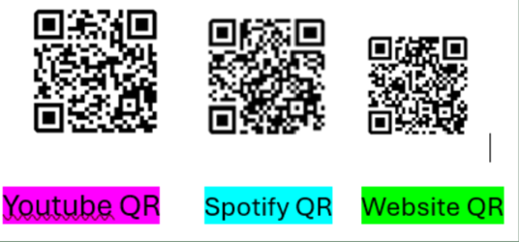

Episode 56XRB September 8, 2024, Jeopardy. Kewaunee to Saint Croix. At or below 80% median income in Wisconsin Counties in order to get Heat Pump Rebate up to $8,000
PLEASE CLICK TO START THE GAME!

Slide 2







$ 200
$ 200
$ 200
$ 200
$ 200
$ 200
$ 400
$ 400
$ 400
$ 400
$ 400
$ 400
$ 600
$ 600
$ 600
$ 600
$ 600
$ 600
$ 800
$ 800
$ 800
$ 800
$ 800
$ 800
$ 1000
$ 1000
$ 1000
$ 1000
$ 1000
$ 1000

Slide 3


Slide 4
Category 1)
Kewaunee La Crosse Lafayette Langlade or Lincoln Wisconsin County

Slide 6

Category 2)
Manitowoc Marathon Marinette Marquette or Menominee Wisconsin County

Slide 8

Category 3)
Milwaukee Monroe Oconto Oneida or Outagamie Wisconsin County

Slide 10
Category 4)
Ozaukee Pepin Pierce Polk or Portage Wisconsin County

Slide 12
Category 5)
Price Racine Richland Rock or Rusk Wisconsin County

Slide 14
Category 6)
Sauk Sawyer Shawano Sheboygan or Saint Croix Wisconsin County

Slide 15












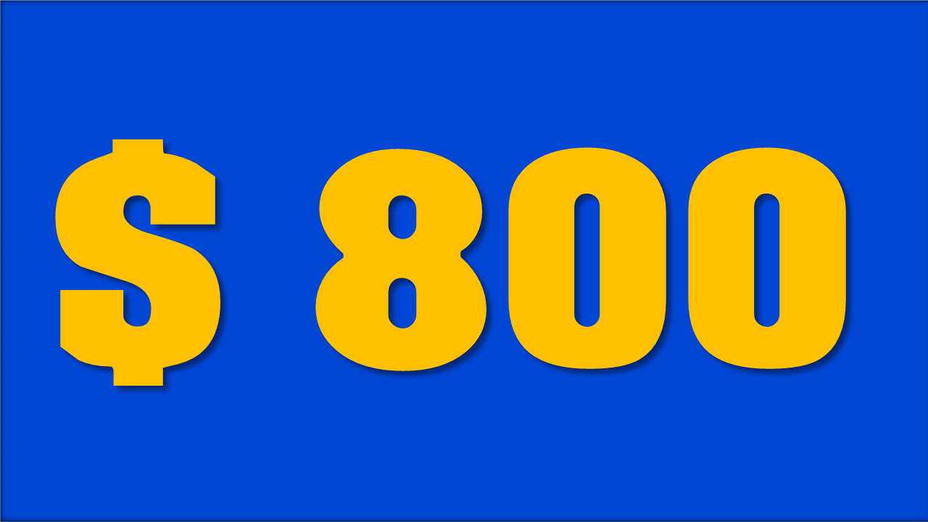




















RHYME
TIME!
MOVIE
CLASSICS
EASY BUT
SO MEAN
-QUESTIONS-
HAIRY AFFAIR
BROADWAY
MUSICALS
POPULAR SPEECHES
YOU FINISHED THIS GAME
TIME TO COUNT THE MONEY!

Slide 16
Category 1, $200 Answer,
Persons in Family
1 | 2 | 3 | 4 | 5 | 6 | 7 | 8
Low (80%) Income Limits ($) Top of Form Bottom of Form | 54,900 | 62,750 | 70,600 | 78,400 | 84,700 | 90,950 | 97,250 | 103,500
Kewaunee County Wisconsin is part of the
Green Bay WI HUD Metro Fair Market Rents
FMR Area.
Click here for the answer

Slide 17
Solution:
Category 1, $200 Question, What is Kewaunee County Wisconsin?
$ 200

Slide 18
Category 1, $400 Answer,
Persons in amily
1 | 2 | 3 | 4 | 5 | 6 | 7 | 8
Low (80%) Income Limits ($) Top of Form Bottom of Form | 55,100 | 63,000 | 70,850 | 78,700 | 85,000 | 91,300 | 97,600 | 103,900
La Crosse County Wisconsin is part of the La Crosse-Onalaska, Wisconsin Minnesota Metropolitan Statistical Area WI-MN MSA.
Click here for the answer

Slide 19
Solution:
Category 1, $400 Question, What is La Crosse County Wisconsin?
$ 400

Slide 20
Category 1, $600 Answer,
Persons in Family
1 | 2 | 3 | 4 | 5 | 6 | 7 | 8
Low (80%) Income Limits ($) Top of Form Bottom of Form | 49,000 | 56,000 | 63,000 | 70,000 | 75,600 | 81,200 | 86,800 | 92,400
Lafayette County Wisconsin
Click here for the answer

Slide 21
Solution:
Category 1, $600 Question, What is Lafayette County Wisconsin?
$ 600

Slide 22
Category 1, $800 Answer,
Persons in Family
1 | 2 | 3 | 4 | 5 | 6 | 7 | 8
Low (80%) Income Limits ($) Top of Form Bottom of Form | 48,550 | 55,450 | 62,400 | 69,300 | 74,850 | 80,400 | 85,950 | 91,500
Langlade County Wisconsin
Click here for the answer

Slide 23
Category 1, $800 Question, What is Langlade County Wisconsin?
$ 800

Slide 24
Category 1, $1,000 Answer,
Persons in Family
1 | 2 | 3 | 4 | 5 | 6 | 7 | 8
Low (80%) Income Limits ($) Top of Form Bottom of Form | 50,750 | 58,000 | 65,250 | 72,500 | 78,300 | 84,100 | 89,900 | 95,700
Lincoln County Wisconsin
Click here for the answer

Slide 25
Solution:
Category 1, $1,000 Question, What is Lincoln County Wisconsin?
$ 1000

Slide 26
Category 2, $200 Answer,
Persons in Family
1 | 2 | 3 | 4 | 5 | 6 | 7 | 8
Low (80%) Income Limits ($) Top of Form Bottom of Form | 48,550 | 55,450 | 62,400 | 69,300 | 74,850 | 80,400 | 85,950 | 91,500
Manitowoc County Wisconsin
Click here for the answer

Slide 27
Solution:
Category 2, $200 Question, What is Manitowoc County Wisconsin?
$ 200

Slide 28
Category 2, $400 Answer,
Persons in Family
1 | 2 | 3 | 4 | 5 | 6 | 7 | 8
Low (80%) Income Limits ($) Top of Form Bottom of Form | 53,100 | 60,700 | 68,300 | 75,850 | 81,950 | 88,000 | 94,100 | 100,150
Marathon County Wisconsin is part of the Wausau WI HUD Metro FMR Area.
Click here for the answer

Slide 29
Solution:
Category 2, $400 Question, What is Marathon County Wisconsin?
$ 400

Slide 30
Category 2, $600 Answer,
Persons in Family
1 | 2 | 3 | 4 | 5 | 6 | 7 | 8
Low (80%) Income Limits ($) Top of Form Bottom of Form | 48,550 | 55,450 | 62,400 | 69,300 | 74,850 | 80,400 | 85,950 | 91,500
Marinette County Wisconsin
Click here for the answer

Slide 31
Solution:
Category 2, $600 Question, What is Marinette County Wisconsin?
$ 600

Slide 32
Category 2, $800 Answer,
Persons in Family
1 | 2 | 3 | 4 | 5 | 6 | 7 | 8
Low (80%) Income Limits ($) Top of Form Bottom of Form | 48,550 | 55,450 | 62,400 | 69,300 | 74,850 | 80,400 | 85,950 | 91,500
Marquette County Wisconsin
Click here for the answer

Slide 33
Solution:
Category 2, $800 Question, What is Marquette County Wisconsin?
$ 800

Slide 34
Category 2, $1,000 Answer,
Persons in Family
1 | 2 | 3 | 4 | 5 | 6 | 7 | 8
Low (80%) Income Limits ($) Top of Form Bottom of Form | 48,550 | 55,450 | 62,400 | 69,300 | 74,850 | 80,400 | 85,950 | 91,500
Menominee County Wisconsin
Click here for the answer

Slide 35
Solution:
Category 2, $1,000 Question, What is Menominee County Wisconsin?
$ 1000

Slide 36
Category 3, $200 Answer,
Persons in Family
1 | 2 | 3 | 4 | 5 | 6 | 7 | 8
Low (80%) Income Limits ($) Top of Form Bottom of Form | 57,200 | 65,400 | 73,550 | 81,700 | 88,250 | 94,800 | 101,350 | 107,850
Milwaukee County Wisconsin is part
of the Milwaukee-Waukesha-
West Allis WI Metropolitan Statistical
Area MSA.
Click here for the answer

Slide 37
Solution:
Category 3, $200 Question, What is Milwaukee County Wisconsin?
$ 200

Slide 38
Category 3, $400 Answer,
Persons in Family
1 | 2 | 3 | 4 | 5 | 6 | 7 | 8
Low (80%) Income Limits ($) Top of Form Bottom of Form | 48,550 | 55,450 | 62,400 | 69,300 | 74,850 | 80,400 | 85,950 | 91,500
Monroe County Wisconsin
Click here for the answer

Slide 39
Solution:
Category 3, $400 Question, What is Monroe County Wisconsin?
$ 400

Slide 40
Category 3, $600 Answer,
Persons in Family
1 | 2 | 3 | 4 | 5 | 6 | 7 | 8
Low (80%) Income Limits ($) Top of Form Bottom of Form | 52,350 | 59,800 | 67,300 | 74,800 | 80,750 | 86,750 | 92,750 | 98,750
Oconto County Wisconsin
Click here for the answer

Slide 41
Solution:
Category 3, $600 Question, What is Oconto County Wisconsin?
$ 600

Slide 42
Category 3, $800 Answer,
Persons in Family
1 | 2 | 3 | 4 | 5 | 6 | 7 | 8
Low (80%) Income Limits ($) Top of Form Bottom of Form | 49,950 | 57,100 | 64,250 | 71,350 | 77,100 | 82,800 | 88,500 | 94,200
Oneida County Wisconsin
Click here for the answer

Slide 43
Solution:
Category 3, $800 Question, What is Oneida County Wisconsin?
$ 800

Slide 44
Category 3, $1,000 Answer,
Persons in Family
1 | 2 | 3 | 4 | 5 | 6 | 7 | 8
Low (80%) Income Limits ($) Top of Form Bottom of Form | 58,250 | 66,600 | 74,900 | 83,200 | 89,900 | 96,550 | 103,200 | 109,850
Outagamie County Wisconsin is part of the Appleton WI Metropolitan Statistical Area MSA. The Appleton, WI MSA contains Calumet County WI and Outagamie County WI.
Click here for the answer

Slide 45
Category 3, $1,000 Question, What is Outagamie County Wisconsin?
$ 1000

Slide 46
Category 4, $200 Answer,
Persons in Family
1 | 2 | 3 | 4 | 5 | 6 | 7 | 8
Low (80%) Income Limits ($) Top of Form Bottom of Form | 57,200 | 65,400 | 73,550 | 81,700 | 88,250 | 94,800 | 101,350 | 107,850
Ozaukee County Wisconsin is part of the Milwaukee-Waukesha-West Allis, WI Metropolitan Statistical Area MSA.The Milwaukee-Waukesha-West Allis, WI MSA contains Milwaukee County, WI Ozaukee County, WI Washington County, WI and Waukesha County WI.
Click here for the answer

Slide 47
Solution:
Category 4, $200 Question, What is Ozaukee County Wisconsin?
$ 200

Slide 48
Category 4, $400 Answer,
Persons in Family
1 | 2 | 3 | 4 | 5 | 6 | 7 | 8
Low (80%) Income Limits ($) Top of Form Bottom of Form | 49,850 | 57,000 | 64,100 | 71,200 | 76,900 | 82,600 | 88,300 | 94,000
Pepin County Wisconsin
Click here for the answer

Slide 49
Category 4, $400 Question, What is Pepin County Wisconsin?
$ 400

Slide 50
Category 4, $600 Answer,
Persons in Family
1 | 2 | 3 | 4 | 5 | 6 | 7 | 8
Low (80%) Income Limits ($) Top of Form Bottom of Form | 68,500 | 78,250 | 88,050 | 97,800 | 105,650 | 113,450 | 121,300 | 129,100
Pierce County Wisconsin is part of the
Minneapolis-St. Paul-Bloomington, MN-WI
HUD Metro Fair Market Rents FMR Area.
Click here for the answer

Slide 51
Category 4, $600 Question, What is Pierce County Wisconsin?
$ 600

Slide 52
Category 4, $800 Answer,
Persons in Family
1 | 2 | 3 | 4 | 5 | 6 | 7 | 8
Low (80%) Income Limits ($) Top of Form Bottom of Form | 51,550 | 58,900 | 66,250 | 73,600 | 79,500 | 85,400 | 91,300 | 97,200
Polk County Wisconsin
Click here for the answer

Slide 53
Solution:
Category 4, $800 Question, What is Polk County Wisconsin?
$ 800

Slide 54
Category 4, $1,000 Answer,
Persons in Family
1 | 2 | 3 | 4 | 5 | 6 | 7 | 8
Low (80%) Income Limits ($) Top of Form Bottom of Form | 55,550 | 63,450 | 71,400 | 79,300 | 85,650 | 92,000 | 98,350 | 104,700
Portage County Wisconsin
Click here for the answer

Slide 55
Solution:
Category 4, $1,000 Question, What is Portage County Wisconsin?
$ 1000

Slide 56
Category 5, $200 Answer,
Persons in Family
1 | 2 | 3 | 4 | 5 | 6 | 7 | 8
Low (80%) Income Limits ($) Top of Form Bottom of Form | 48,550 | 55,450 | 62,400 | 69,300 | 74,850 | 80,400 | 85,950 | 91,500
Price County Wisconsin
Click here for the answer

Slide 57
Solution:
Category 5, $200 Question, What is Price County Wisconsin?
$ 200

Slide 58
Category 5, $600 Answer,
Persons in Family
1 | 2 | 3 | 4 | 5 | 6 | 7 | 8
Low (80%) Income Limits ($) Top of Form Bottom of Form | 54,500 | 62,300 | 70,100 | 77,850 | 84,100 | 90,350 | 96,550 | 102,800
Racine County Wisconsin
Click here for the answer

Slide 59
Solution:
Category 5, $400 Question, What is Racine County Wisconsin?
$ 400

Slide 60
Category 5, $600 Answer,
Persons in Family
1 | 2 | 3 | 4 | 5 | 6 | 7 | 8
Low (80%) Income Limits ($) Top of Form Bottom of Form | 48,550 | 55,450 | 62,400 | 69,300 | 74,850 | 80,400 | 85,950 | 91,500
Richland County Wisconsin
Click here for the answer

Slide 61
Solution:
Category 5, $600 Question, What is Richland County Wisconsin?
$ 600

Slide 62
Category 5, $800 Answer,
Persons in Family
1 | 2 | 3 | 4 | 5 | 6 | 7 | 8
Low (80%) Income Limits ($) Top of Form Bottom of Form | 48,550 | 55,450 | 62,400 | 69,300 | 74,850 | 80,400 | 85,950 | 91,500
Rock County Wisconsin is part of the
Janesville-Beloit WI Metropolitan Statistical
Area MSA.
Click here for the answer

Slide 63
Category 5, $800 Question, What is Rock County Wisconsin?
$ 800

Slide 64
Category 5, $1,000 Answer,
Persons in Family
1 | 2 | 3 | 4 | 5 | 6 | 7 | 8
Low (80%) Income Limits ($) Top of Form Bottom of Form | 48,550 | 55,450 | 62,400 | 69,300 | 74,850 | 80,400 | 85,950 | 91,500
Rusk County Wisconsin
Click here for the answer

Slide 65
Solution:
Category 5, $1,000 Question, What is Rusk County Wisconsin?
$ 1000

Slide 66
Category 6 $200 Answer,
Persons in Family
1 | 2 | 3 | 4 | 5 | 6 | 7 | 8
Low (80%) Income Limits ($) Top of Form Bottom of Form | 53,600 | 61,250 | 68,900 | 76,550 | 82,700 | 88,800 | 94,950 | 101,050
Sauk County Wisconsin
Click here for the answer

Slide 67
Category 6 $200 Question, What is Sauk County Wisconsin?
$ 200

Slide 68
Category 6, $400 Answer,
Persons in Family
1 | 2 | 3 | 4 | 5 | 6 | 7 | 8
Low (80%) Income Limits ($) Top of Form Bottom of Form | 48,550 | 55,450 | 62,400 | 69,300 | 74,850 | 80,400 | 85,950 | 91,500
Sawyer County Wisconsin
Click here for the answer

Slide 69
Category 6, $400 Question, What is Sawyer County Wisconsin?
$ 400

Slide 70
Category 6, $600 Answer,
Persons in Family
1 | 2 | 3 | 4 | 5 | 6 | 7 | 8
Low (80%) Income Limits ($) Top of Form Bottom of Form | 48,550 | 55,450 | 62,400 | 69,300 | 74,850 | 80,400 | 85,950 | 91,500
Shawano County Wisconsin
Click here for the answer

Slide 71
Category 6, $600 Question, What is Shawano County Wisconsin?
$ 600

Slide 72
Category 6, $800 Answer,
Persons in Family
1 | 2 | 3 | 4 | 5 | 6 | 7 | 8
Low (80%) Income Limits ($) Top of Form Bottom of Form | 48,650 | 55,600 | 62,550 | 69,450 | 75,050 | 80,600 | 86,150 | 91,700
Sheboygan County Wisconsin
Click here for the answer

Slide 73
Solution:
Category 6, $800 Question, What is Sheboygan County Wisconsin?
$ 800

Slide 74
Category 6, $1,000 Answer,
Persons in Family
1 | 2 | 3 | 4 | 5 | 6 | 7 | 8
Low (80%) Income Limits ($) Top of Form Bottom of Form | 68,500 | 78,250 | 88,050 | 97,800 | 105,650 | 113,450 | 121,300 | 129,100
Saint Croix County Wisconsin is part of the Minneapolis-St. Paul-Bloomington, MN-WI HUD Metro Fair Market Rents FMR Area.
Click here for the answer

Slide 75
Category 6, $1,000 Question, What is Saint Croix County Wisconsin?
Double Jeopardy if no action is taken to stop wood burning.
$ 1000

