Slide 1

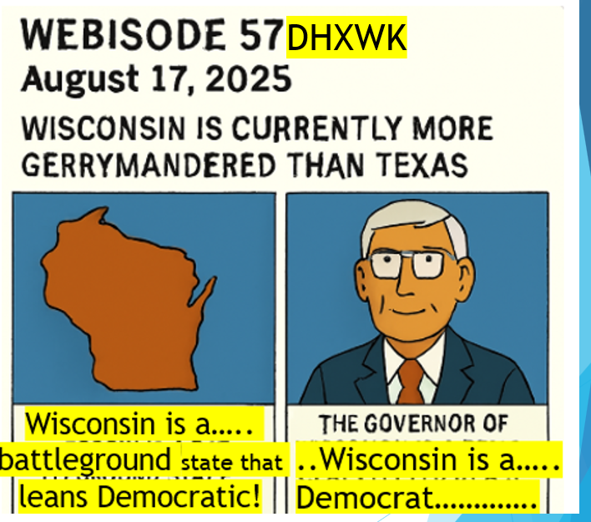
Webisode 57DHXWK August 17 2025 Wisconsin is currently more gerrymandered than Texas Cartoon 1 of 3 Cell 1 Unlike Texas Wisconsin is a battleground state that leans Democratic! Cell 2 The Governor of Wisconsin is a Democrat elected by a statewide vote that cannot be gerrymandered!

