Slide 1
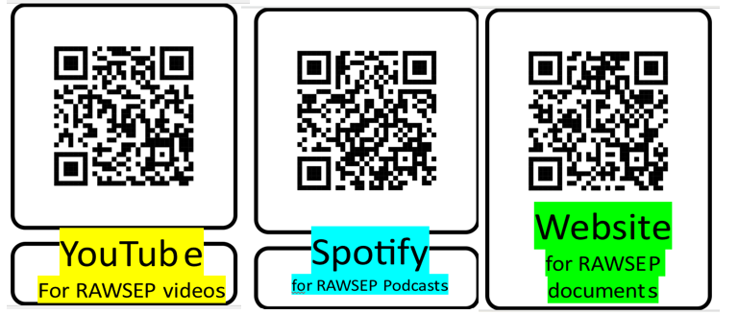
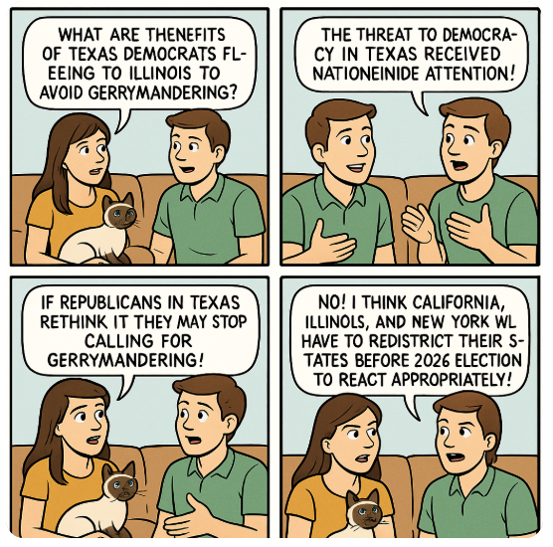
…BENEFITS
DEMOCRACY
……
…..
FLEEING
-WIDE..
Episode 57DHXWE August 11, 2025,
Why did Texas Democrats flee the state before gerrymandering?
WILL
…
STATES

