Slide 1

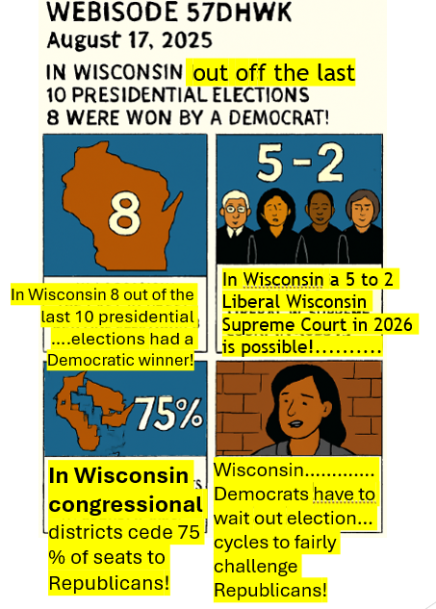
Cartoon 3 of 4 Cell 1 In Wisconsin 8 out of the last 10 presidential elections had a Democratic winner! Cell 2 In Wisconsin a 5 to 2 Liberal WI Supreme Court in 2026 is possible! Cell 3 In Wisconsin congressional districts cede 75 % of seats to Republicans! Cell 4 In 2023 more representative maps were allowed but Wisconsin Democrats have to wait out election cycles to fairly challenge Republicans!

