Slide 1

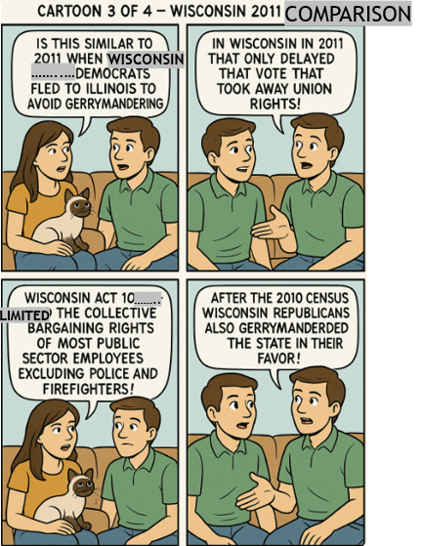
Episode 57DHXWE August 11, 2025,
Why did Texas Democrats flee the state before gerrymandering?

