Slide 1
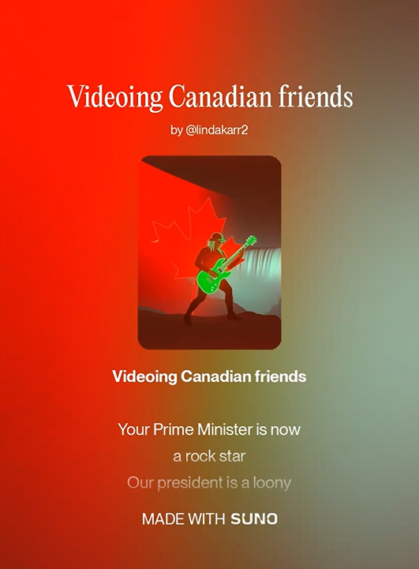
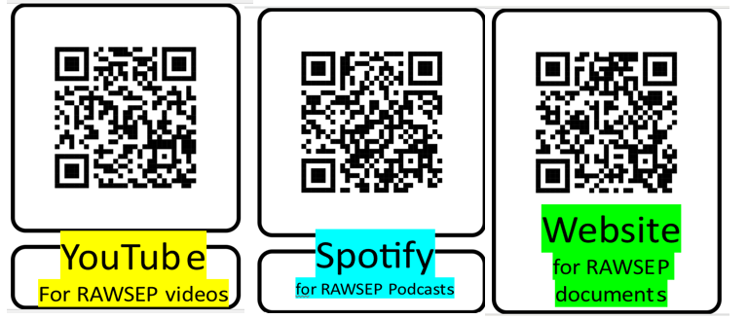
Webisode 57DHYAFZE
Videoing Canadian Friends
January 24 2026

