Slide 1
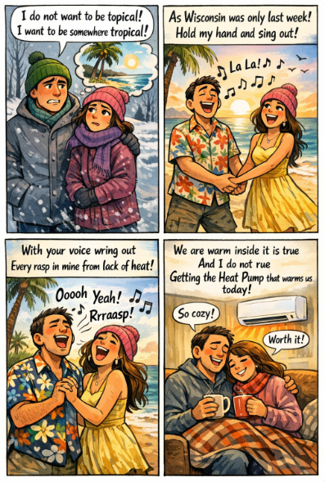
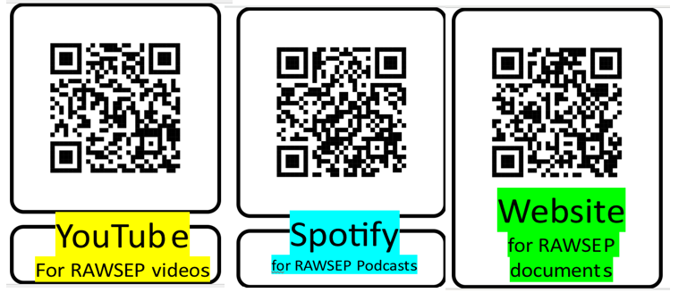
The Topical Song version 1
Web 57DHYAFZXB1

Slide 2
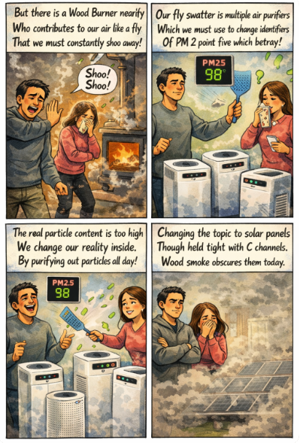
The Topical Song version 1
Web 57DHYAFZXB1

Slide 3
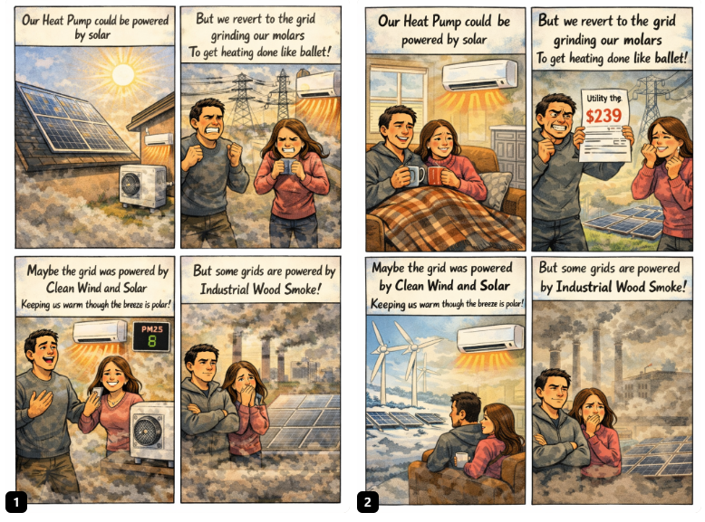
The Topical Song version 1
Web 57DHYAFZXB1

Slide 4
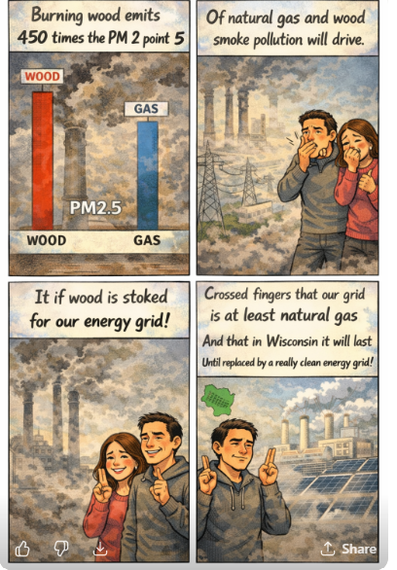
The Topical Song version 1
Web 57DHYAFZXB1

