Slide 1
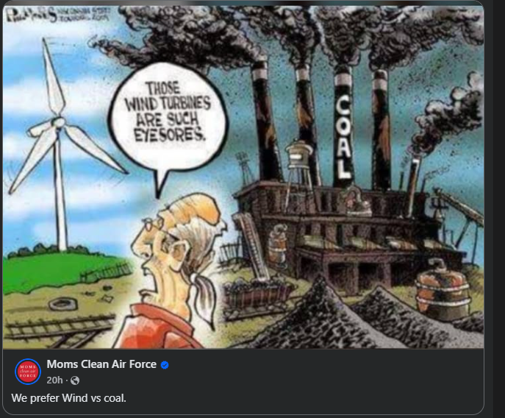
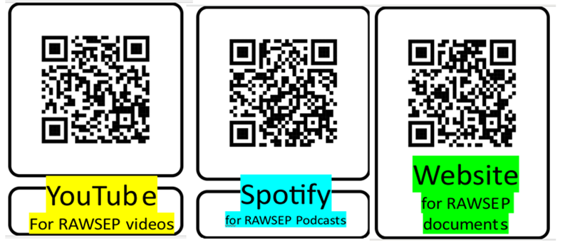
Welcome to our Music and Photo Extravaganza
January 29 2026
Webisode 57DHYAFZXP

Slide 2
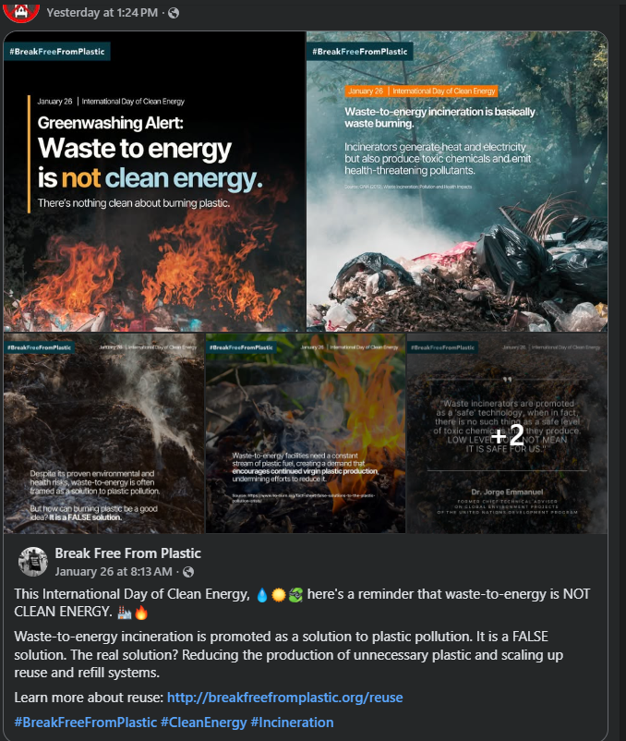
Welcome to our Music and Photo Extravaganza
January 29 2026
Webisode 57DHYAFZXP

Slide 3

Welcome to our Music and Photo Extravaganza
January 29 2026
Webisode 57DHYAFZXP

Slide 4
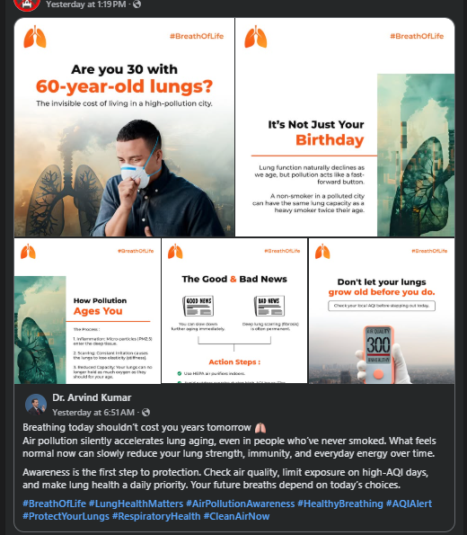
Welcome to our Music and Photo Extravaganza
January 29 2026
Webisode 57DHYAFZXP

Slide 5
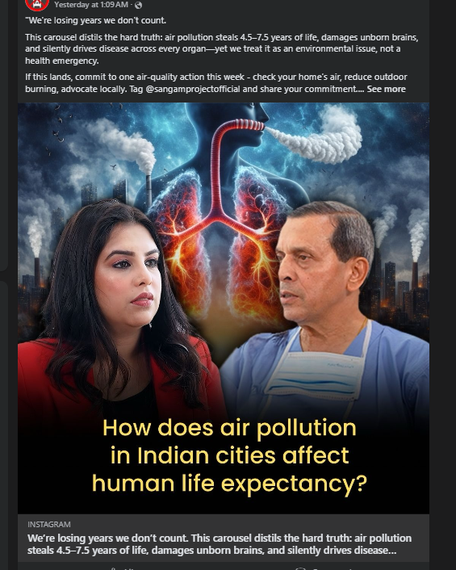
Welcome to our Music and Photo Extravaganza
January 29 2026
Webisode 57DHYAFZXP

Slide 6
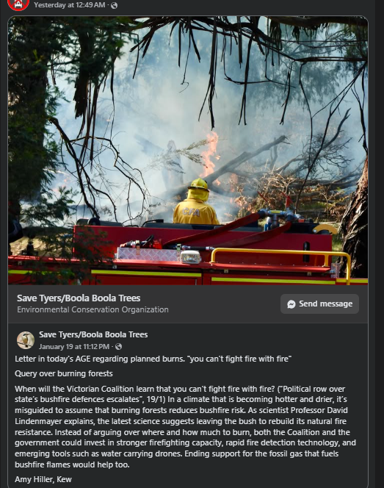
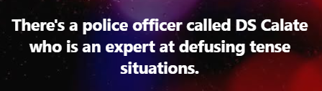
Welcome to our Music and Photo Extravaganza
January 29 2026
Webisode 57DHYAFZXP

Slide 7

Welcome to our Music and Photo Extravaganza
January 29 2026
Webisode 57DHYAFZXP

Slide 8
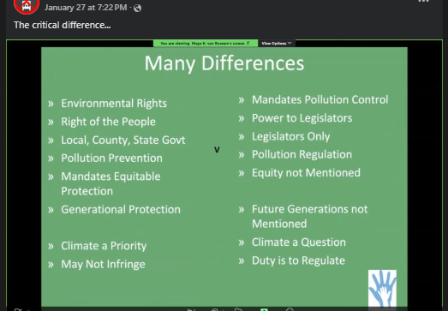
Welcome to our Music and Photo Extravaganza
January 29 2026
Webisode 57DHYAFZXP

Slide 9
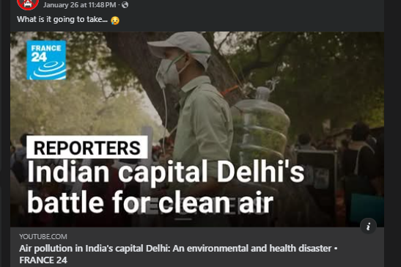
Welcome to our Music and Photo Extravaganza
January 29 2026
Webisode 57DHYAFZXP

Slide 10
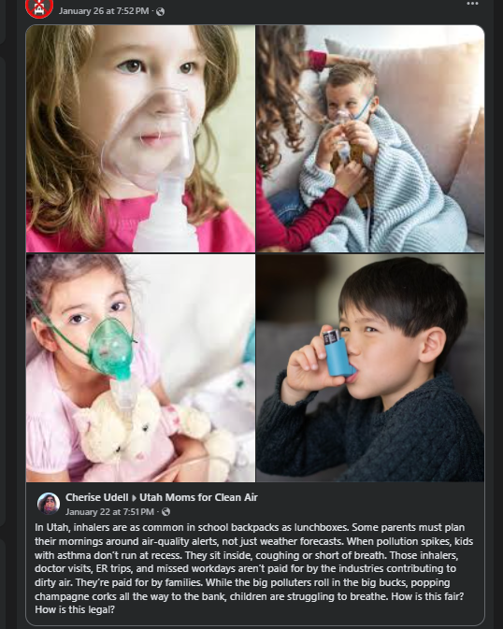
Welcome to our Music and Photo Extravaganza
January 29 2026
Webisode 57DHYAFZXP

Slide 11
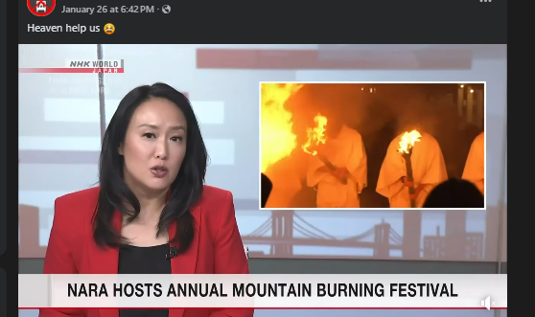
Welcome to our Music and Photo Extravaganza
January 29 2026
Webisode 57DHYAFZXP

Slide 12

Welcome to our Music and Photo Extravaganza
January 29 2026
Webisode 57DHYAFZXP

Slide 13
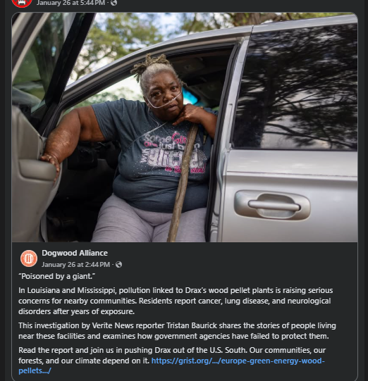
Welcome to our Music and Photo Extravaganza
January 29 2026
Webisode 57DHYAFZXP

Slide 14

Welcome to our Music and Photo Extravaganza
January 29 2026
Webisode 57DHYAFZXP

Slide 15
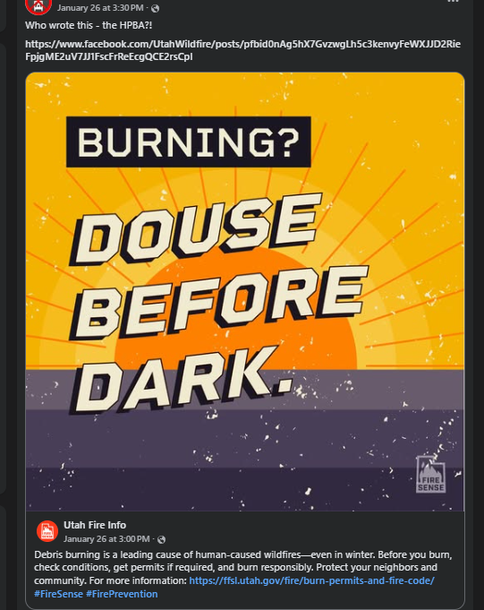
Welcome to our Music and Photo Extravaganza
January 29 2026
Webisode 57DHYAFZXP

Slide 16

Welcome to our Music and Photo Extravaganza
January 29 2026
Webisode 57DHYAFZXP

Slide 17


Welcome to our Music and Photo Extravaganza
January 29 2026
Webisode 57DHYAFZXP

Slide 18
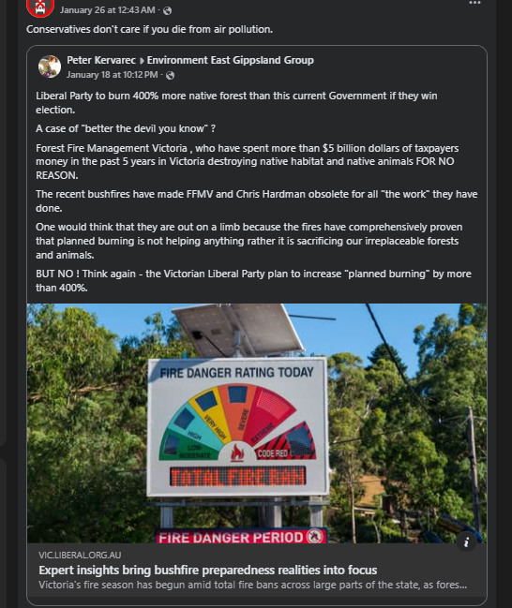
Welcome to our Music and Photo Extravaganza
January 29 2026
Webisode 57DHYAFZXP

Slide 19
Welcome to our Music and Photo Extravaganza
January 29 2026
Webisode 57DHYAFZXP

Slide 20

Welcome to our Music and Photo Extravaganza
January 29 2026
Webisode 57DHYAFZXP

Slide 21

Welcome to our Music and Photo Extravaganza
January 29 2026
Webisode 57DHYAFZXP

Slide 22
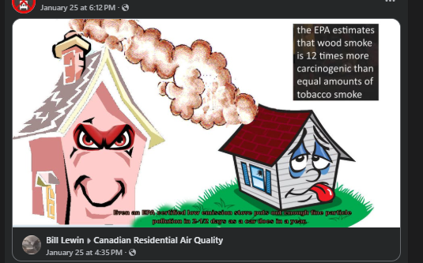
Welcome to our Music and Photo Extravaganza
January 29 2026
Webisode 57DHYAFZXP

Slide 23
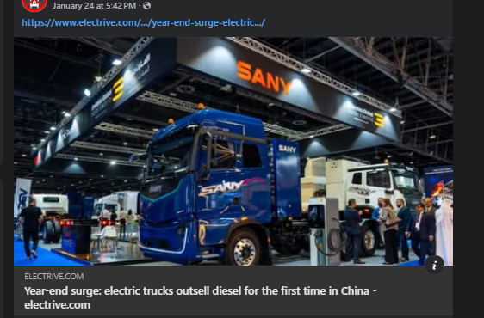
Welcome to our Music and Photo Extravaganza
January 29 2026
Webisode 57DHYAFZXP

Slide 24
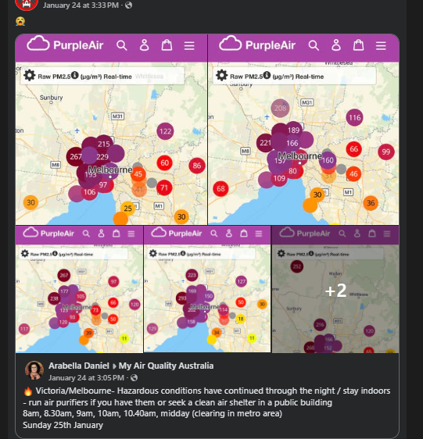
Welcome to our Music and Photo Extravaganza
January 29 2026
Webisode 57DHYAFZXP

Slide 25
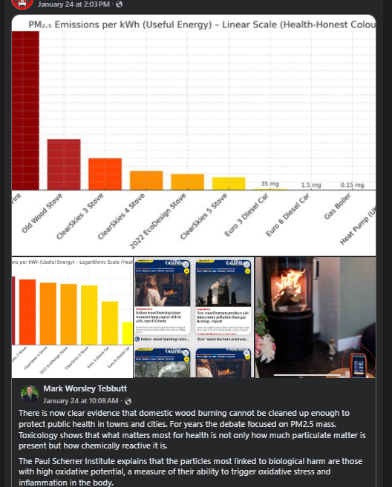
Welcome to our Music and Photo Extravaganza
January 29 2026
Webisode 57DHYAFZXP

Slide 26
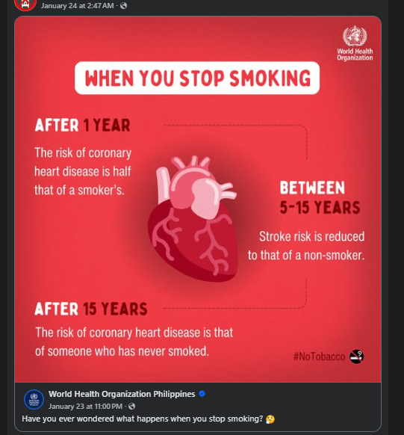
Welcome to our Music and Photo Extravaganza
January 29 2026
Webisode 57DHYAFZXP

